Slide 1
New Student Orientation
Medical Physics August 27, 2018

Slide 2
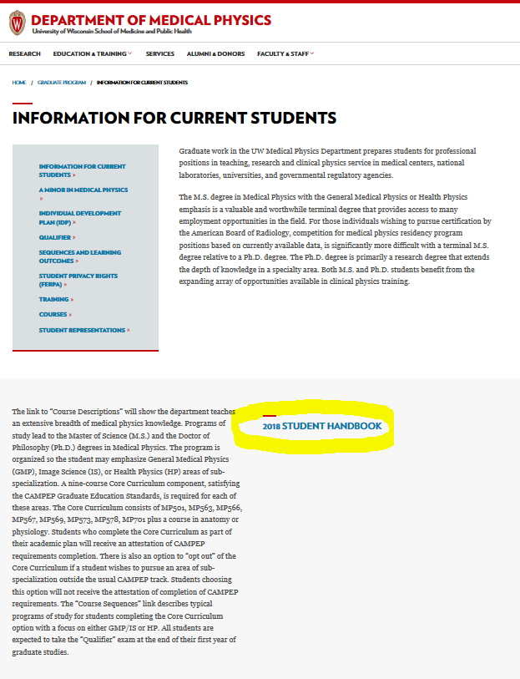
The Handbook
Your Guide to everything
you need to know…

Slide 3
Important Deadlines
First Year Activities (and every Fall term):
Review and sign the compact First Fall Semester
Update Personal data/ Pre-UW (Education Portal) First Fall Semester
Complete Individual Development Plan/Upload November 1st of each year
Update completed course-work into Education Portal Fall and Spring (verified each summer)
Form 3-member Mentor Committee First Spring and then meet yearly

Slide 4
Important Deadlines
Complete all MP core and 1 Advanced MP course(s) First Two Years
Oral Qualifier Examination Summer after 4 Semesters
Apply for Master’s degree (course option) After Passing Qualifier
Preliminary Examination Within First year after Qualifier
Complete Minor Requirement Before Preliminary Examination

Slide 5
Where To Go…
The Handbook
Your Advisor
Carol Aspinwall
Your Peers (But beware of urban legends!)

